Slide 1

Your Fertility and Family Building Benefit
Baylor University

Slide 2



Our mission is to make everyone’s dream of parenthood come true

Slide 3



Progyny enables access to treatment for all paths to parenthood
1 in 5 women are impacted by fertility; Black women 2x more likely¹
1/3 of the time infertility is male-factor ¹
1 CDC; infertility prevalence for heterosexual women, https://www.cdc.gov/reproductivehealth/features/what-is-infertility/index.html | 2LGBTQ Family Building Survey, https://www.familyequality.org/resources/lgbtq-family-building-survey/

Slide 4





Progyny fertility and family building
Supporting preconception, fertility, adoption and surrogacy
Comprehensive, equitable benefit design
Superior clinical outcomes
More live births
Faster time to pregnancy
Fewer miscarriages
Fewer twins and triplets
Better-supported employees,
high employee satisfaction
Large, managed network
of top providers
Connected
tech platform enabling data sharing across entire benefit
Personalized support Dedicated PCA and digital companion
Integrated medical and Rx
Note: All percentages are comparing Progyny to national averages. Progyny represents Progyny in-network provider clinic averages for Progyny members only based on the 12-month period ended December 31, 2021. For each Progyny outcome presented, the p-value when compared to the national average is <0.0001. | 1 Calculated based on the Society for Assisted Reproductive Technology, or SART, 2019 National Summary Report, finalized in 2022 | 2 Calculated based on CDC, 2020 National Summary and Clinic Data Sets, published in 2022

Slide 5
Superior outcomes delivering more healthy pregnancies and babies
More healthy pregnancies
More healthy babies
Fewer high-risk pregnancies and NICU visits
Actual outcomes
for all members
at all clinics
Independently verified
17% higher
pregnancy rate
per IVF transfer¹
25% lower
miscarriage
rate¹
27% higher
live birth
rate²
26% higher
single embryo
transfer rate¹
66% lower
IVF multiples
rate²
63.0%
54.3%
91.0%
9.6%
19.5%
18.6%
18.3%
Data based on 12-month period ended December 31, 2021, representing 9,633 transfers.
1: For each Progyny outcome, the p-value when compared to the national average is <0.0001. 1: Calculated based on the Society for Assisted Reproductive Technology, or SART, 2019 National Summary Report, finalized in 2022.
2: Calculated based on CDC, 2020 National Summary and Clinic Data Sets, published in 2022.
54.1%
55.5%
75.6%
50.1%
42.7%
44.1%
72.5%
7.4%
13.9%
39.4%
63.3%
6.5%
OON
Progyny
Nat Avg
OON
2.5%
INN
Nat Avg
OON
OON
INN
Nat Avg
Progyny
INN
Nat Avg
Progyny
INN
INN
Progyny
Nat Avg
Progyny
OON
Out of network clinic average | National Average | In-network clinic average for all patients (includes non-Progyny patients at clinic) | Only Progyny Patients

Slide 6

The Smart Cycle works for everyone
All individual services are bundled into the Smart Cycle, enabling evidence-based care
Complex sperm wash & prep
Cycle management
Insemination
Office visits
Simple sperm wash & prep
Ultrasounds & in-cycle bloodwork (W3, P4, beta hCG, FSH, LH)
Anesthesia (for egg retrieval)
Assisted hatching
Blastocyst culture
Complex sperm wash & prep
Cycle management
Embryo biopsy
Embryo culture lab
Intracytoplasmic sperm injection (ICSI)
Office visits
Oocyte fertilization/ insemination
Oocyte identification
Preimplantation genetic testing for aneuploidy (PGT-A)
Preparation and cryopreservation of extra embryo(s)
Retrieval (follicular aspiration, to include ultrasound guidance)
Simple sperm wash & prep
Tissue storage (1 year)
Ultrasounds & in-cycle bloodwork (E2, P4, beta hCG, FSH, LH)
Fertility medications
Cycle management
Embryo thaw
Embryo transfer (eSET) w/ultrasound guidance
Office visits
Preparation of embryo(s) for transfer
Ultrasounds & in-cycle bloodwork (E2, P4, beta hCG, FSH, LH)

Slide 7
Equitable and comprehensive benefit design
All individual services are bundled into comprehensive Progyny Smart Cycles™
Treatment services are expressed as fractions that deduct from the Smart Cycles, so you always know your benefit balance
Ensures equitable care regardless of race, geography, or path to parenthood

Slide 8



The Smart Cycle supports all paths to parenthood
Onboarding with their dedicated PCA and preconception support
IUI
1/4
Smart Cycle
Used
IUI
Onboarding with their dedicated PCA and preconception support
Remaining healthy embryos in storage
1
Smart Cycle
Used
IVF
IVF Freeze All
Frozen Embryo Transfer
PGT included
Onboarding with their dedicated PCA surrogacy coach
Referral to surrogacy agency
Their surrogate is pregnant with a baby girl
Path to Surrogacy
1 1/2
Smart Cycles
Used
Purchase of 1 Cohort of Donor Eggs
Surrogacy Embryology Services
Pre-transfer services
Remaining healthy embryos in storage
Matched with their surrogate

Slide 9

The Smart Cycle supports all paths to parenthood
Fertility Preservation
1/2
Smart Cycles
Used
Fertility
Preservation
Retrieved eggs
in storage
1¼
Smart Cycles
Utilized
IVF
(using donor sperm)
Purchase 4 Vials of Donor Sperm
IVF Freeze All
Frozen Embryo Transfer

Slide 10




Dedicated high-touch, concierge member support
Your journey is supported by a dedicated Patient Care Advocate (PCA), education, and digital support.
Unlimited, comprehensive support: PCAs provide emotional support, guidance, education, and care facilitation
Inclusive, culturally competent care: Support for every journey to parenthood, including adoption and surrogacy​
PCAs meet members where they are: member portal, app, phone, secure messaging
Digital tools to enhance the experience: Comprehensive member portal that is a one stop for everything a member needs; Progyny Rx app tracks delivery with real-time updates
On-demand education: content, video series and curated podcast covering fertility, nutrition, pregnancy, and more by experts
PCAs are reproductive health and fertility experts

Slide 11






























Large provider network with premier fertility specialists
950+ fertility specialists at 650+ locations
Only the top providers join the Progyny network:
Must meet quality and volume standards to be considered for network
Board certified; 100+ ART cycles annually​
Clinical guidelines set by a Medical Advisory Board of REIs in accordance with ASRM​
Network includes reproductive endocrinologists, reproductive urologists, and embryology labs

Slide 12

Enhanced reproductive urology services
Progyny is the first and only solution with a curated network of top reproductive urologists
Members have access to reproductive urology services covered by Progyny (no Smart Cycle deduction) for a seamless member experience
New curated content available developed in conjunction with reproductive urologists, including a services overview and FAQs

Slide 13
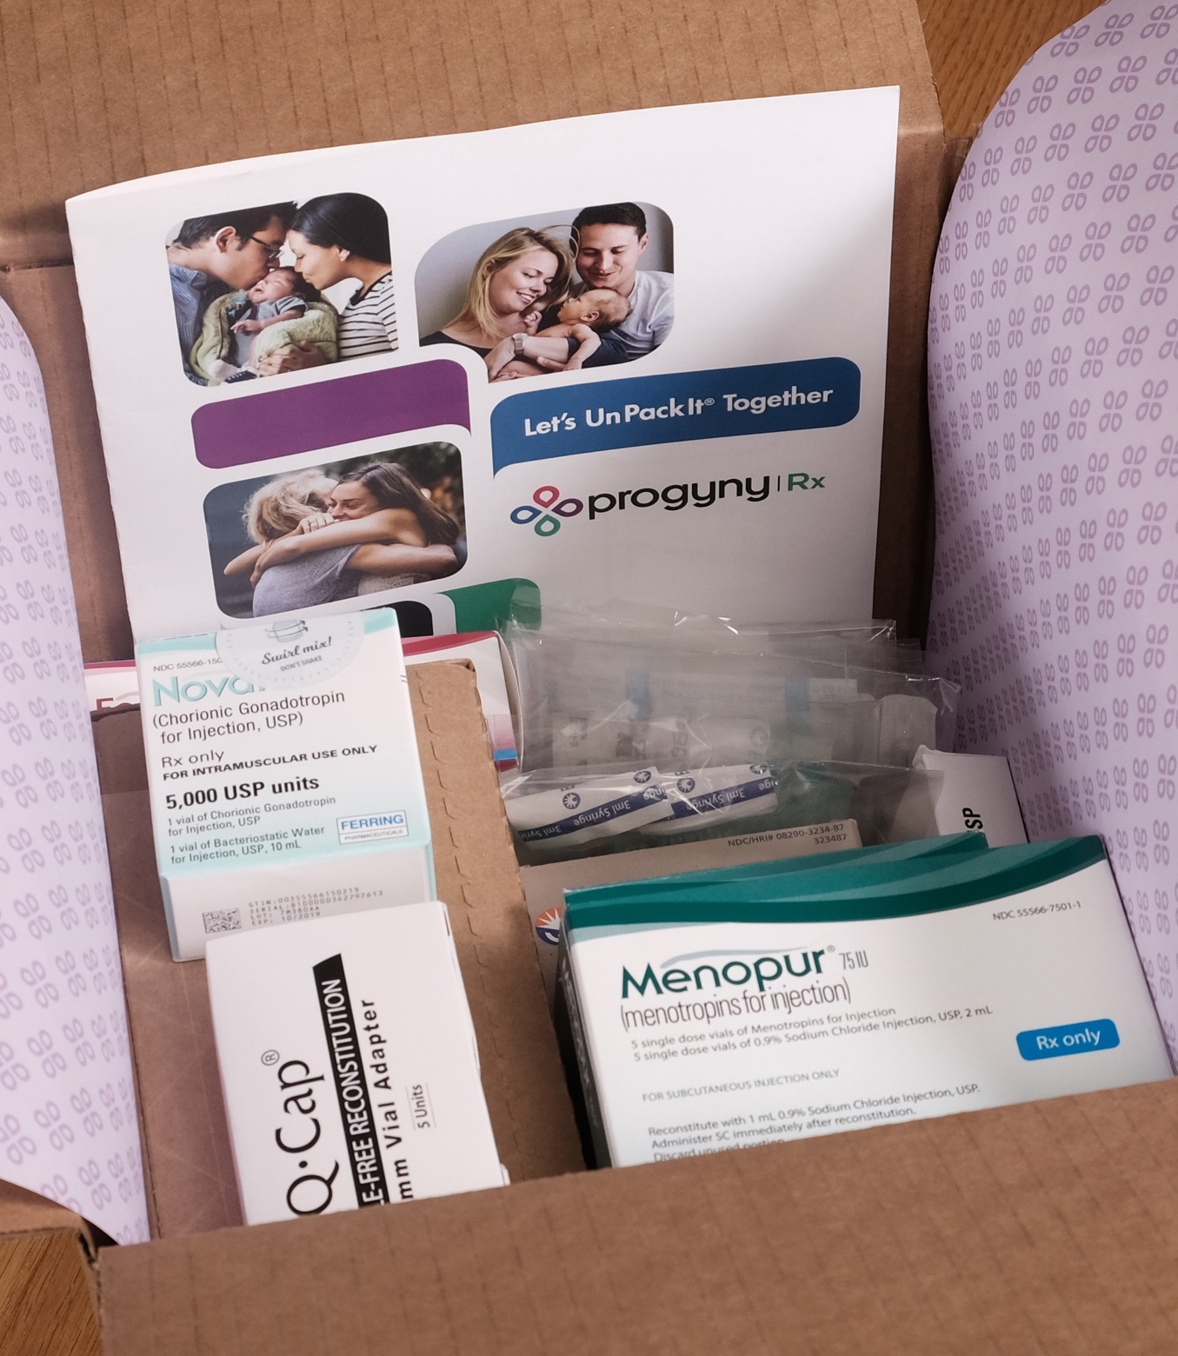
Integrated pharmacy program
Simplified pharmacy programs creates stress-free medication experience
Treatment and medication are authorized simultaneously to prevent any delays in care
Same day or next day delivery
UnPack It™ call with pharmacy clinician with every delivery to explain your medications and how to administer and store them
24/7 drug administration counseling and clinical support
Helpful medication instruction videos at progyny.com/rx

Slide 14
Your Progyny benefit
You have access to Unlimited Smart Cycles
Members must be enrolled in one of the following medical plans to have access to the Progyny benefit:
Insurance Plan Deductible, Out-of-Pocket Max | PPO Individual | PPO Family | HDHP Individual | HDHP Family
Deductible | $500.00 | $1,500.00 | $1,500.00 | $3,000.00
Coinsurance | 20% | 20% | 20% | 20%
Out-of-Pocket Max | $4,000.00 | $8,500.00 | $5,000.00 | $10,000.00
Notes:
-Effective XX.XX.XX, CLIENT employees/members will have access to XX Smart Cycles
-Members must be enrolled in one of the following CLIENT’s eligible medical plans in order to have access to the Progyny benefit
-If a member’s spouse or domestic partner is also going to be using the Progyny benefit either through testing and/or treatment, they will also have to be enrolled in one of the following CLIENT’s eligible medical plans.

Slide 15
Understanding your financial responsibility
Simplifying Insurance Terminology
Your premium is the amount you pay per month for your insurance.
At the start of each calendar year, you will pay for all services until you reach your deductible.
Once you’ve reached your deductible, you and your insurer both pay a percentage of your covered healthcare services. This is called co-insurance and/or co-pay.
You and your insurer continue to split the costs of your covered healthcare services (according to the co-insurance percentage) until you reach your out-of-pocket maximum (OOP).
After you reach your out-of-pocket maximum, your insurer will pay 100% of the costs of your covered health care services for the rest of the calendar year.

Slide 16
Understanding your financial responsibility
Example: Initial consultation
NOTE: While initial consultations do not impact your Smart Cycle balance, there is cost share responsibility.
Insurance Plan Cost to Member/Plan | PPO Individual
Provider Fee for Initial Consultation (A covered service) | $3,000
Deductible ($500) | $500
Coinsurance (20%) | $500
Progyny Coverage | $2,000
Member Financial Responsibility (Billed by Progyny to member) | $1,000
Deductible / OOP Max Remaining ($4,000) | $0/$3,000
Please be advised this is an estimate for illustration purposes only. Your financial responsibility will depend on the service, provider and specifics of your treatment and benefit plan.

Slide 17
Understanding your financial responsibility
Example: IVF Fresh Cycle
Insurance Plan Cost to Member/Plan | PPO Individual
Provider Fee for IVF Fresh Cycle (A covered service) | $20,000
Deductible ($0) | $0
Coinsurance (20%) | $3,000
Progyny Coverage | $17,000
Member Financial Responsibility (Billed by Progyny to member) | $3,000
Deductible / OOP Max Remaining ($3,000) | $0/$0
Please be advised this is an estimate for illustration purposes only. Your financial responsibility will depend on the service, provider and specifics of your treatment and benefit plan.

Slide 18
Understanding your financial responsibility
Example: Progyny Rx medications for IVF Fresh Cycle
Insurance Plan Cost to Member/Plan | PPO Individual
Progyny Rx medications for IVF Fresh Cycle (covered medications) | $9,000
Deductible ($0) | $0
Coinsurance (20%) | $0
Progyny Coverage | $9,000
Member Financial Responsibility (Billed by Progyny to member) | $0
Deductible / OOP Max Remaining ($0) | $0/$0
Please be advised this is an estimate for illustration purposes only. Your financial responsibility will depend on the service, provider and specifics of your treatment and benefit plan.

Slide 19
Transition of care
If you will be in the middle of treatment during the Progyny effective date
If you already have a provider and need to confirm their network status
If you are preparing to start treatment
Please call 877.370.8951 and speak to your dedicated PCA
Phone lines are open!

Slide 20

We’re here to help!
Connect with your dedicated PCA to:
Learn more about your covered services and network of fertility specialists
Activate your Progyny benefit
877.370.8951

